Slide 1
CI/CD + Terraform
Back-to-back classes on reviewable software and infrastructure change
CI/CD fundamentals
Hands-on workflow lab
Branch protection gates
Notes:
Frame the two classes as one workflow.
GitHub Actions provides automated evidence for application changes.
Terraform provides plan evidence for infrastructure changes.

Slide 2
Automation exposes the process
A pipeline does not make a weak process strong.
It makes the process visible, repeatable, and easier to improve.
A failed run is useful feedback, not a personal failure.
The goal is a team that can change software safely.
Notes:
Explain Pipelines:
A pipeline is a way to ensure everyone is following the same standards.
Normalize errors before the lab begins.
Students will hit indentation mistakes, missing dependencies, and failing tests.
The habit we want is calm diagnosis from logs.

Slide 3
References and lab resources
RESOURCES
Day 1
GitHub Actions documentation: docs.github.com/actions
Workflow syntax: docs.github.com/actions/using-workflows/workflow-syntax-for-github-actions
GitHub Skills lab: github.com/skills/test-with-actions
Day 2
Terraform CLI commands: developer.hashicorp.com/terraform/cli/commands
terraform_data resource: developer.hashicorp.com/terraform/language/resources/terraform-data
Terraform values and modules: developer.hashicorp.com/terraform/language/values
Notes:
Use this slide as the closing resource list for students.
The Terraform lab path intentionally avoids provider credentials and cloud cost.

Slide 4
Back-to-back class flow
WORKSHOP MAP
Part 1: CI/CD with GitHub Actions
Build a pull-request pipeline that tests code and protects merges.
Bridge: what evidence should exist before a change is accepted?
Part 2: Terraform without cloud access
Practice plan, apply, state, modules, and CI checks locally.
Notes:
Make the handoff explicit: CI/CD is not only app deployment; it is a change-control habit.
Terraform gives infrastructure the same reviewable change path.
CI/CD is change management
Terraform is like building a lego set as code, its the instructions and also knows when there are changes to the infrastructure

Slide 5
CI/CD turns each change into evidence
Continuous integration asks: does this change still work with the rest of the code?
Continuous delivery asks: is this change packaged and ready to release?
Full Automation
Continuous deployment asks: can release happen automatically after all gates pass?
DevOps connects build, operate, secure, and support work into one visible path.
Notes:
Many teams say CI/CD when they only mean tests.
Use the distinction to explain why approvals, artifacts, and verification belong in the conversation.

Slide 6
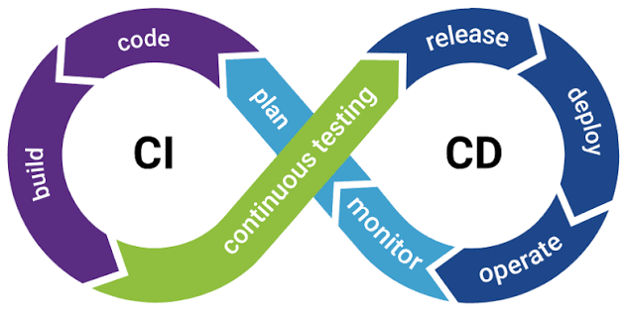
CI/CD is three related practices
CI: merge small changes often and test automatically.
Continuous delivery: keep a release-ready artifact with a human production gate.
Continuous deployment: release automatically after every required gate passes.
A team can adopt these in stages; automation grows with trust.
Notes:
Use one bug-fix example moving through branch, pull request, checks, artifact, staging, and production.
Ask where a human approval belongs in their environment.

Slide 7
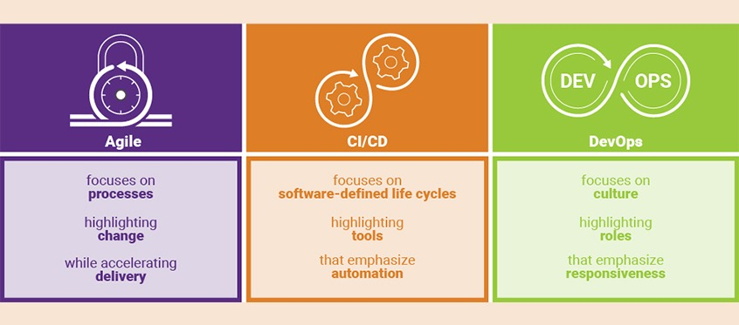
DevOps is shared ownership of change
Notes:
Use the visual to connect Agile, CI/CD, and DevOps.
CI/CD is the technical path where quality checks, reviews, and release evidence become visible.

Slide 8
Automation changes the feedback loop
Fast feedback: problems appear while the change is still small.
Consistency: every change runs through the same checks.
Traceability: commits, runs, logs, artifacts, and approvals connect.
Quality gates: tests and reviews happen before merge.
Lower release stress: smaller changes are easier to reason about.
1. Write code on a branch
2. Commit and push
3. Open a pull request
4. GitHub Actions starts from the repository event
5. Runner checks out code and installs dependencies
6. Build, test, lint, and package
7. Required checks and review gate the merge
Notes:
Most students will name speed first.
Point out that traceability and repeatability often become the bigger operational value.

Slide 9
8. Deploy, verify, monitor, and recover when needed
A pipeline is a repeatable path from change to release
Notes:
The important shift is from 'I ran it on my machine' to 'the repository can prove this change.'
Point to the workflow run as the shared source of evidence.
Example Time:https://github.com/CyberDave80/CI/blob/main/.github/workflows/learn-ci.yml

Slide 10
GitHub Actions has five core parts
Event: something happens in the repository.
- Workflow: the YAML automation file that responds.
- Runner: the machine that executes the job.
- Job: A discrete set of steps executed sequentially on a single runner.
- Step: An individual task, executing either a shell command or a pre-built action.
Artifact: a saved output from the run.
Notes:
Have students point to each concept in the workflow file during the lab.

Slide 11
YAML is the pipeline's map
name: human-readable workflow label
on: event that starts the workflow
jobs: one or more units of work
runs-on: runner operating system
steps: ordered actions and commands
uses: call a reusable action
run: execute a shell command
Example path: pull_request -> test job -> checkout -> setup -> test command
Notes:
Show a minimal ci.yml file live rather than crowding this slide.
Emphasize that YAML defines the automation; the runner executes it.
Use actions/checkout and actions/setup-python as examples if using the GitHub Skills lab.

Slide 12
Lab: build a pull-request test pipeline
Starter: https://github.com/skills/test-with-actions
Students will:
1. Create or fork the lab repository
2. Add .github/workflows/ci.yml
3. Trigger a workflow from a pull request
4. Read the workflow log
5. Fix a failing test and confirm the green check
Notes:
Use the official GitHub Skills lab if students do not already have a sample repository.
Have them intentionally break the test before fixing it.

Slide 13
Branch protection turns CI into a merge gate
Protect the main branch from direct, unreviewed changes.
Require pull request review before merge.
Require the CI status check to pass.
Use clear job names so required checks are easy to select.
Keep deployment approval separate from test automation when risk is high.
Notes:
Connect this to the lab: the workflow run becomes part of the merge decision.
If students have limited repository permissions, demo this part instead of requiring every student to configure it.

Slide 14
Troubleshoot the first useful error
Start with the failing job, not the whole workflow.
Open the failed step and read upward to the first real error.
Separate YAML errors from dependency errors and test failures.
Check what changed in the commit.
Make one hypothesis, fix one thing, and run again.
Notes:
Students often read only the last red line.
Model a calm log-reading workflow during the lab.

Slide 15
CI/CD + Terraform
Back-to-back classes on reviewable software and infrastructure change
CI/CD fundamentals
Hands-on workflow lab
Branch protection gates
Notes:
Frame the two classes as one workflow.
GitHub Actions provides automated evidence for application changes.
Terraform provides plan evidence for infrastructure changes.

Slide 16


Terraform Barney Style
Someone tells a construction worker “I want a house; here is the plan”
Construction worker a.k.a Terraform says “okay this is what it will look like based on the documentation you wrote.
“Do you want to apply any changes?“ Before I build say yes if it looks good.
User says “Yes”
Terraform applies magic
Notes:
https://www.youtube.com/watch?v=tomUWcQ0P3k

Slide 17
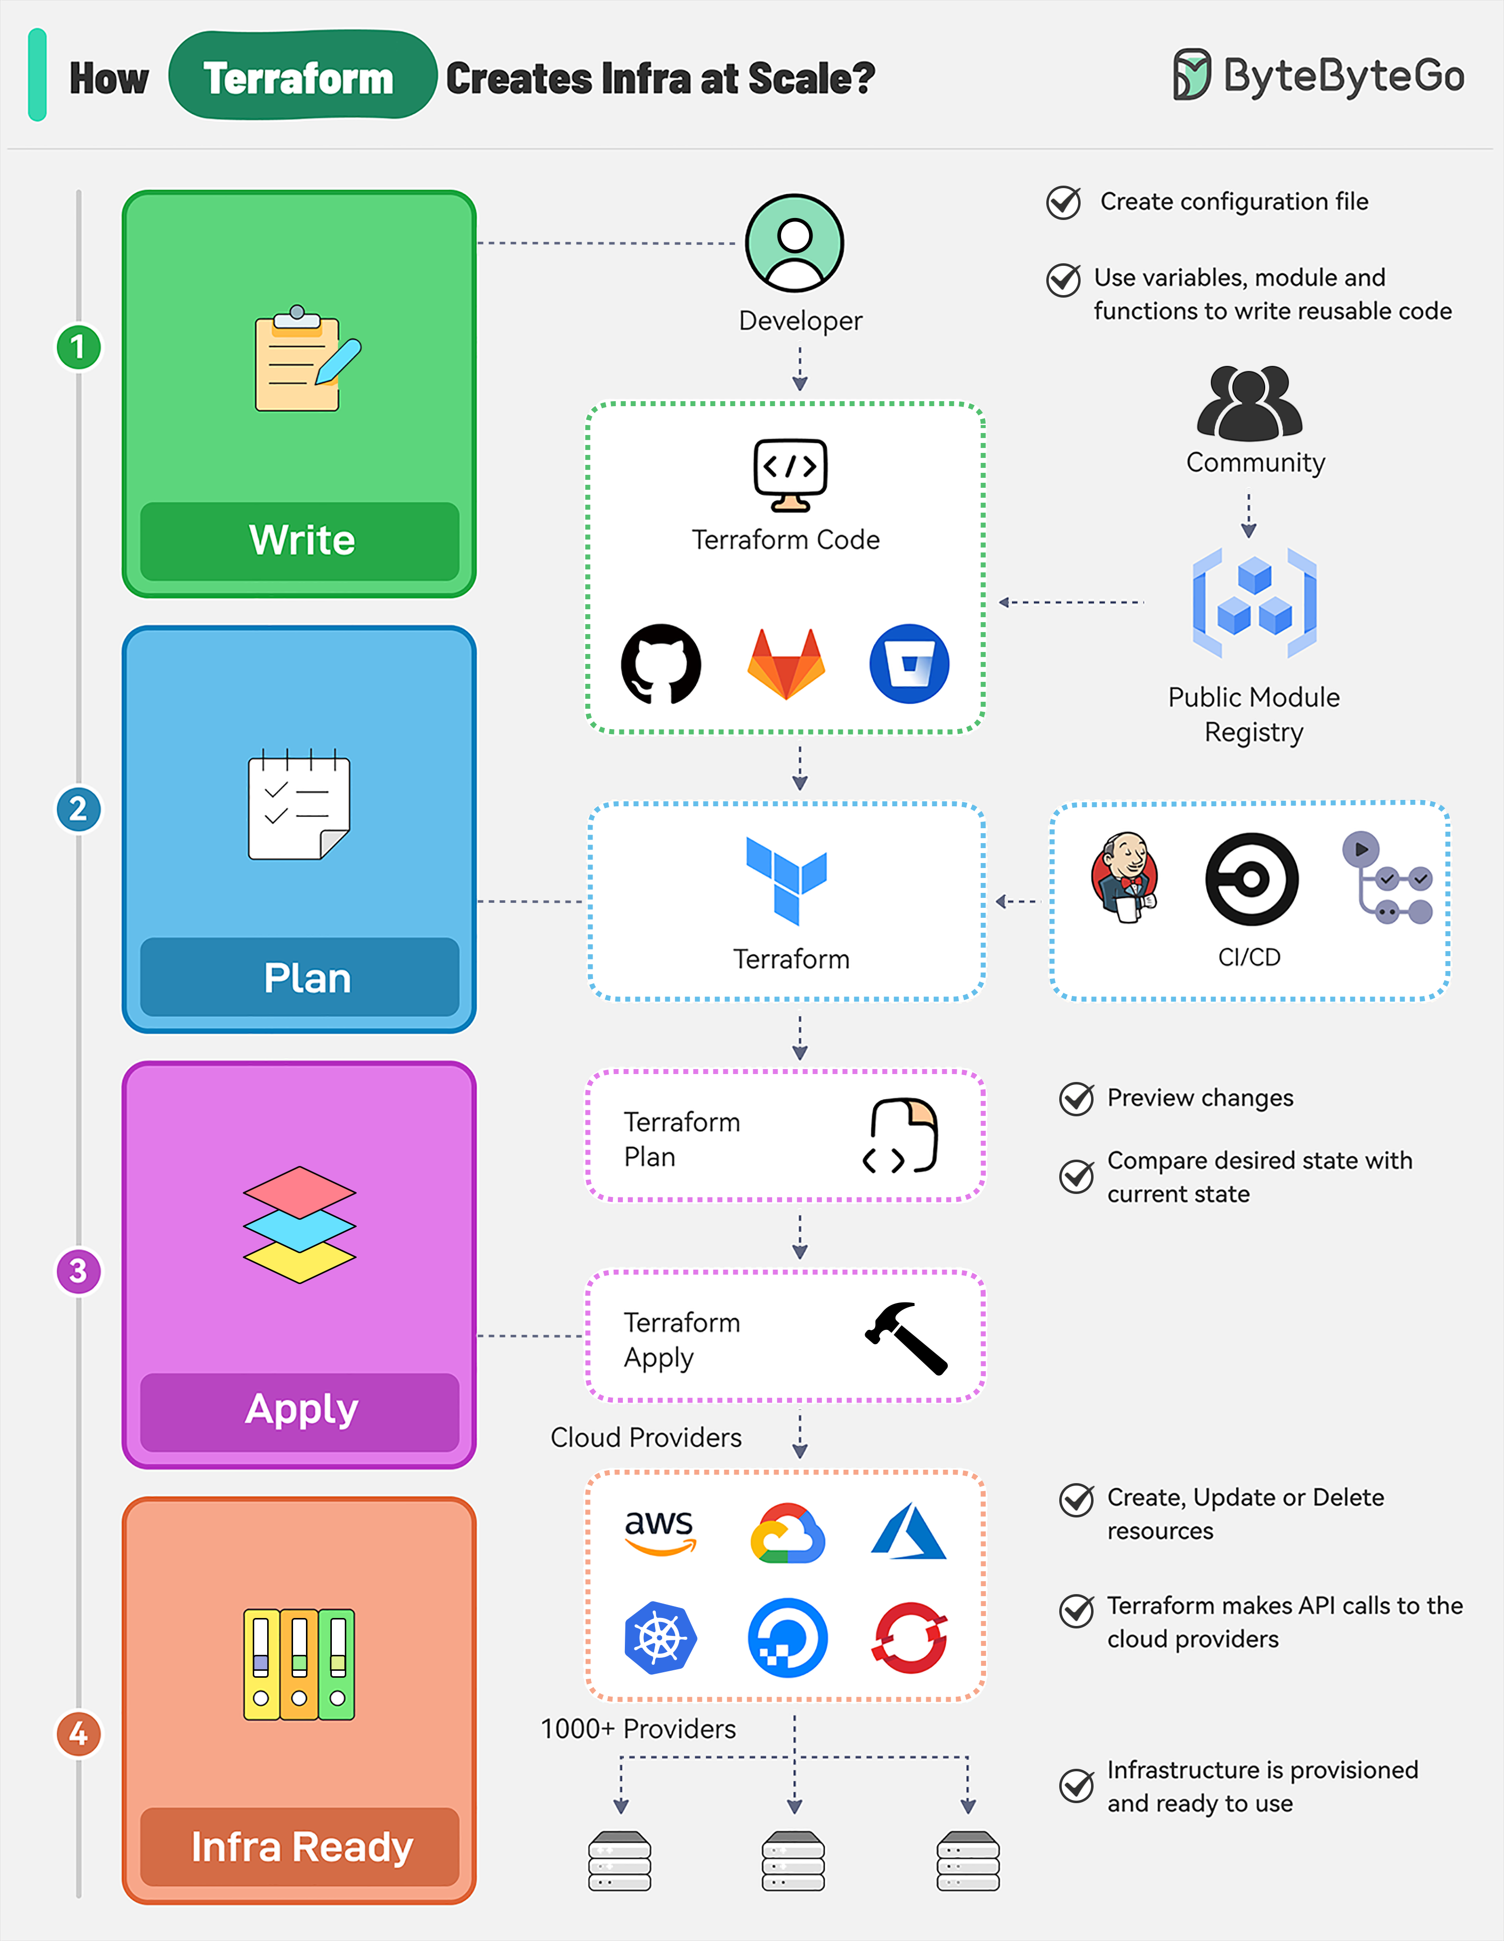
Terraform
Notes:
Write Infrastructure as Code
Define resources, providers, and configurations in Terraform configuration files.
Use variables, modules, and functions to make the code reusable and maintainable.
Integrate with Terraform community registries for ready-to-use modules.
Terraform Plan
Preview the changes Terraform will make to the infrastructure by running “terraform plan”. It can be triggered as part of a CI/CD pipeline.
Terraform compares the desired state defined in the configuration file with the current state in the state file.
Terraform Apply
Run “terraform apply” to create, update, or delete resources based on the plan.
Terraform makes API calls to the specified providers (AWS, Azure, GCP, Kubernetes, etc) to provision the resources.
The state file is updated to reflect the new state of the infrastructure.
Infrastructure Ready
Terraform state file acts as a single source of truth for the current state of the infrastructure.
State file enables version control and collaboration between team members for future changes.

Slide 18
Transition: code checks and infrastructure plans are both evidence
BRIDGE BETWEEN CLASSES
GitHub Actions answers: did the application change pass the required checks?
Terraform plan answers: what infrastructure-like state would change if we apply this?
The second class reuses the same habit from the first class:
small change -> automated check -> readable difference -> review -> controlled apply
Change
Check
Plan
Review
Apply
Notes:
This is the bridge slide between the two back-to-back classes.
Students should recognize the same change discipline before learning Terraform syntax.
Terraform has 3 resources and tracks changes through them
1. Your Terraform configuration files (.tf files) — what you want
variables.tf → inputs (what you give Terraform)
main.tf → resources (what Terraform builds)
outputs.tf → results (what Terraform gives back)
2. The Terraform state file (terraform.tfstate) — what Terraform believes exists (after Apply)
3. The actual infrastructure (AWS/Azure/GCP APIs) — what really exists

Slide 19
The habit is the same across both classes
Write the intended change in code.
Run automated checks.
Preview the difference.
Review before merge or apply.
Keep the path repeatable enough that the next change is safer.
Notes:
End with the common discipline, not the specific tools.
Ask students to name one manual step in their current workflow that can become a checked, reviewable automation. Pull up the repo.
Primary teaching file: variables.tf — this is the safe, intended "change surface."
Students change defaults for service_name, environment, app_version, or owner (or pass -var/-var-file on the CLI) and observe how main.tf and main.tf:1-12 react in the plan/apply/output.
For the module contract discussion (Lab 3), have them look at (but not necessarily edit) variables.tf and outputs.tf to see the inputs/outputs contract.
Advanced/optional: once comfortable, students can add a new run block to release.tftest.hcl to practice writing their own assertions

Slide 20
Capstone: one pull request, two safety nets
INTEGRATED EXERCISE
Students make one pull request that includes:
An application change that must pass CI.
A Terraform change that must pass format, validate, and test or plan review.
The merge decision uses both signals.
PR
App CI
TF checks
Review
Merge
Notes:
If time is limited, run this as an instructor demo.
The goal is to make the two classes feel like one workflow, not two unrelated tools.

Slide 21
Terraform checks fit naturally into GitHub Actions
CI/CD BRIDGE
Pull request checks:
terraform fmt -check
terraform validate
terraform plan or terraform test
Merge/apply path:
controlled branch, protected environment, approval, and state backend
terraform init
terraform fmt -check
terraform validate
terraform test
Notes:
This closes the back-to-back loop.
The same repository workflow can test application code and check Terraform configuration.

Slide 22
State is Terraform's memory
STATE AND CLEANUP
State records Terraform's last known object data.
The plan compares configuration with state.
Outputs help humans and automation read useful results.
Destroy cleans up managed objects from state and the target system.
Never treat state casually when real providers and secrets are involved.
terraform state list
terraform state show terraform_data.release
terraform output -json
terraform destroy
Notes:
In this local lab, state is low risk.
In real work, state can contain sensitive data and needs an appropriate backend, access control, and locking.

Slide 23
HCL gives Terraform a readable contract
CONFIGURATION LANGUAGE
Blocks group configuration.
Arguments assign values.
Variables define inputs.
Locals name reusable expressions.
Outputs expose useful results.
variable "environment" {
type = string
default = "dev"
}
locals {
service_name = "checkout-${var.environment}"
}
output "service_name" {
value = local.service_name
}
Notes:
Keep this lightweight before the lab.
Variables, locals, and outputs are enough to make the first lab feel real without cloud access.

Slide 24
Terraform has five core concepts
MENTAL MODEL
Configuration: what you want.
Providers: APIs Terraform talks to.
Resources: objects Terraform manages.
State: what Terraform believes exists.
Plan and apply: preview the difference, then execute intentionally.
Notes:
Emphasize state early.
Students often treat state as an implementation detail, but it is central to how Terraform tracks managed objects.

Slide 25
The CLI workflow is the class rhythm
TERRAFORM WORKFLOW
Initialize the working directory.
Format and validate the configuration.
Preview the proposed change.
Apply only after reading the plan.
Inspect outputs and state, then clean up.
terraform init
terraform fmt
terraform validate
terraform plan
terraform apply
terraform output
terraform state list
terraform destroy
Notes:
Use the same command rhythm in every lab.
The goal is muscle memory around plan before apply.

Slide 26
Infrastructure as code makes intended change visible
WHY TERRAFORM
Manual changes are hard to review.
Click paths are hard to repeat.
Drift is hard to see.
Plans make proposed changes visible before execution.
State gives Terraform memory across runs.
Notes:
Connect this directly to pull requests: both workflows ask for evidence before accepting change.
The business value is not only automation; it is traceability and repeatability.

Slide 27
Terraform without cloud access
TERRAFORM CLASS OPENING
Terraform is the infrastructure-as-code tool we will use to practice reviewable infrastructure change.
No AWS, Azure, GCP, or Kubernetes account is required.
We will use local state and Terraform's built-in terraform_data resource to learn the workflow safely.
Notes:
Be clear that local training is not pretending to be cloud infrastructure.
It isolates the Terraform workflow from credential, billing, and network complexity.
Reference: Terraform terraform_data stores values that follow a managed resource lifecycle.

Slide 28
Class setup and ground rules
HANDS-ON SETUP
Students need:
Terraform CLI 1.4 or later
A terminal, text editor, and Git repository
No provider credentials and no cloud account
Class rule: read every plan before apply.
Notes:
Terraform 1.4 or later supports terraform_data.
If you want terraform test provider mocking later, use a newer Terraform version, but this deck does not depend on mocking.

Slide 29
Lab 1: First Apply
NO-CLOUD LAB
Goal: This lab walks through the complete Terraform workflow from scratch.
resource "terraform_data" "release" {
input = {
name = local.service_name
environment = var.environment
version = var.app_version
}
}
output "release_record" {
value = terraform_data.release.output
}
Notes:
Have students predict the plan before apply.
Use terraform_data because it stores values in state without needing a cloud provider.

Slide 30
Lab 2: change, re-plan, and explain the difference
CHANGE MANAGEMENT
Goal: see Terraform detect a configuration change.
Change app_version from 1.0.0 to 1.0.1.
Run plan before apply.
Explain what changed, what stayed the same, and where Terraform remembered the old value.
terraform plan -var="app_version=1.0.1"
terraform apply -var="app_version=1.0.1"
terraform show
Notes:
This is the strongest link to CI/CD.
A Terraform plan is the infrastructure equivalent of a reviewable test result and diff.

Slide 31
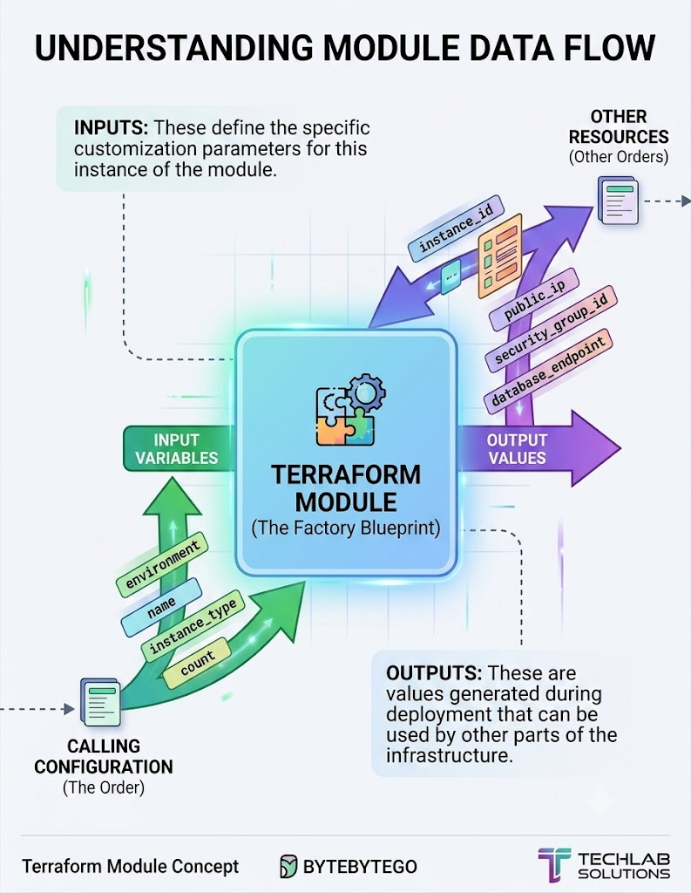
Notes:
Teach modules as an interface, not just as folders.
Inputs and outputs are the contract between caller and module.
Modules are grouped together resources, so your code remains DRY (Don’t Repeat Yourself)
Terraform init downloads modules into a local directory .terraform/modules
Use modules to provision resources which give outputs which we use in the main module outputs

Slide 32
Lab 3: modules turn repeated logic into an interface
MODULES
Goal: move service-release logic into a child module.
Inputs define what the module needs.
Outputs define what the caller receives.
The root module calls the child module with a source path.
module "checkout" {
source = "./modules/service"
name = "checkout"
environment = var.environment
}
output "checkout_service" {
value = module.checkout.service
}
Notes:
Teach modules as an interface, not just as folders.
Inputs and outputs are the contract between caller and module.
Modules are grouped together resources, so your code remains DRY (Don’t Repeat Yourself)
Terraform init downloads modules into a local directory .terraform/modules
Use modules to provision resources which give outputs which we use in the main module outputs

